Slide 1
Sequence alignment continued

Slide 2
Previous lecture…
We did Needleman-Wunsch algorithm to perform global sequence alignment.

Slide 3
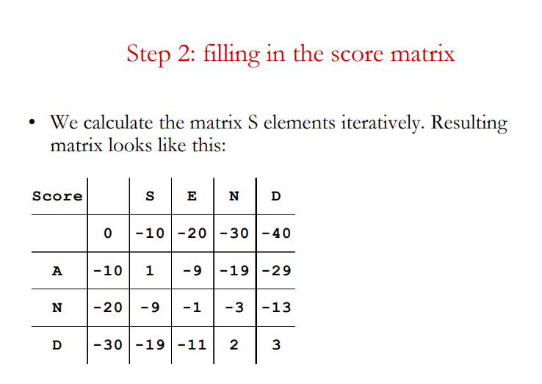
Recap

Slide 4
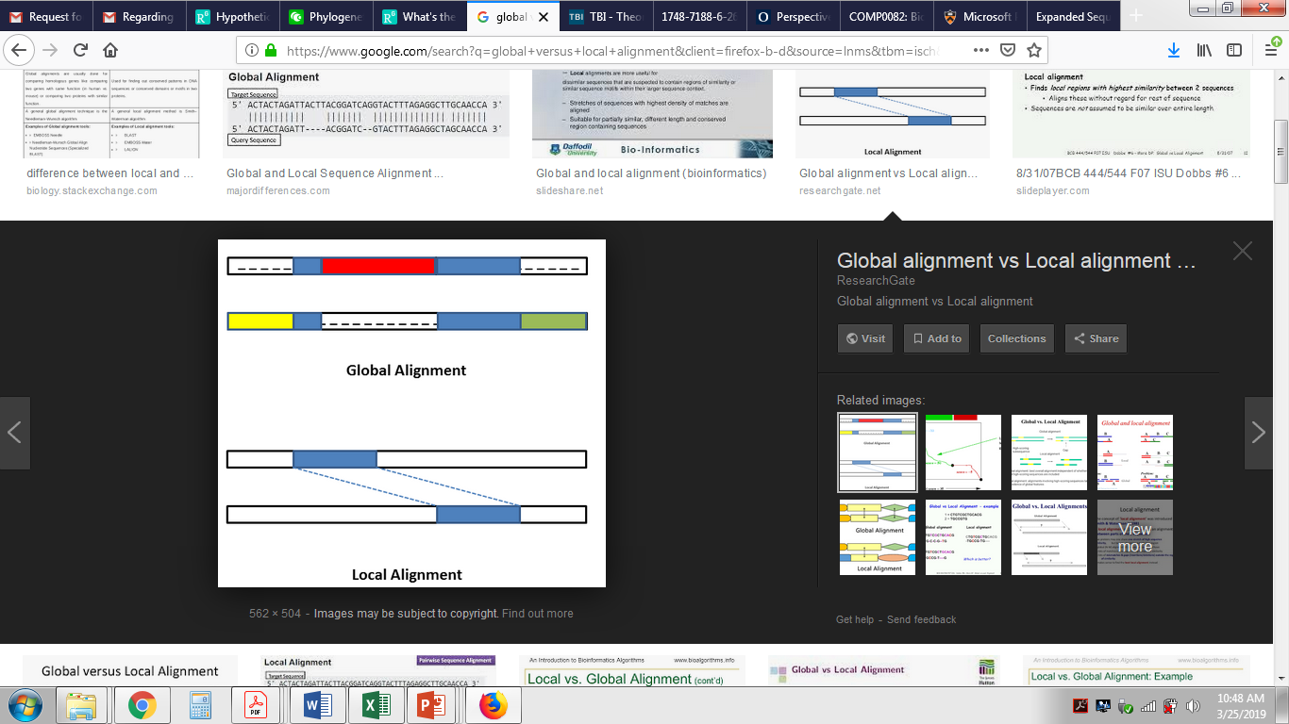
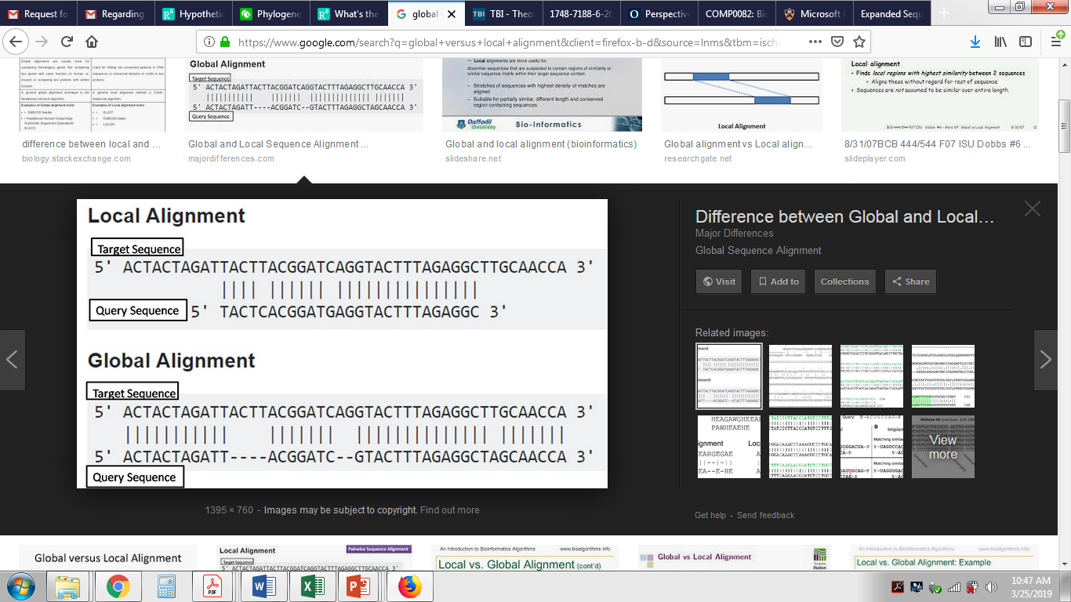
LOCAL vs GLOBAL alignment

Slide 5
Local sequence alignment using Smith Waterman algorithm
Smith Waterman algorithm was first proposed by Temple F. Smith and Michael S. Waterman in 1981. The algorithm explains the local sequence alignment, it gives conserved regions between the two sequences, and one can align two partially overlapping sequences, also it’s possible to align the subsequence of the sequence to itself. These are the main advantages of Local Sequence Alignment.
This algorithm mainly differs within two aspects from the Needleman-Wunsch algorithm. First aspect being, local alignment differs by having only a negative score for the mismatch and when the matrix value becomes negative it has to be set to zero (need to take maximum value of the scorings compared with zero). They are also predefined scoring matrices for nucleotide or protein sequences.

Slide 6
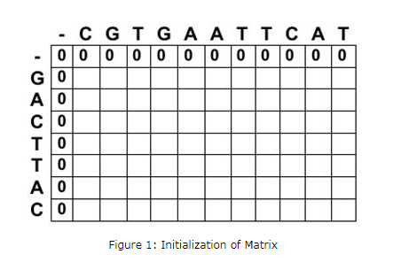
NW vs SW algorithm

Slide 7
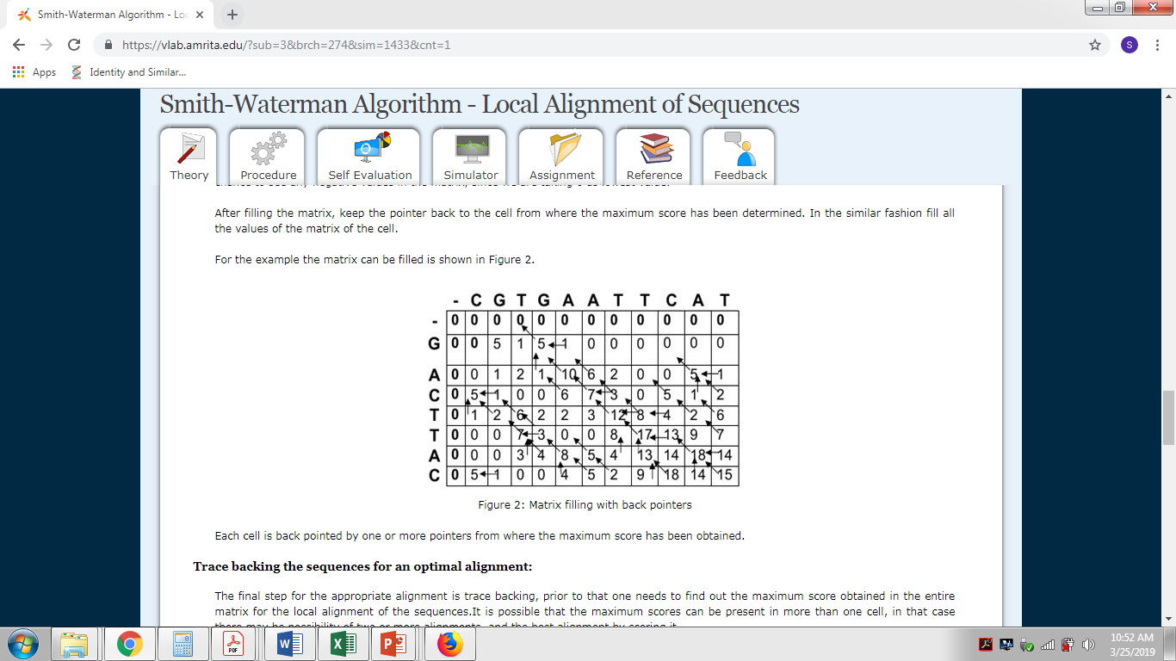
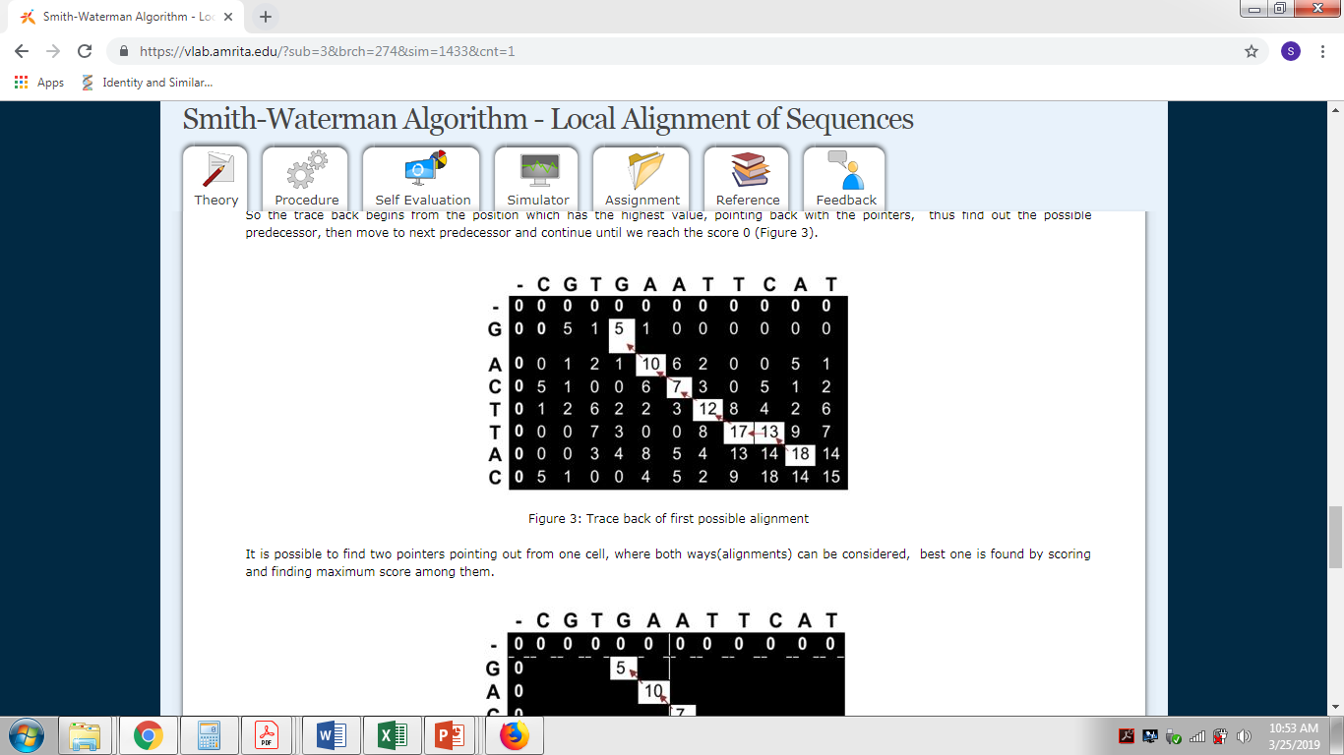

Slide 8
Find the best local alignment
ACCTAAGG
GGCTCAATCA
+2 FOR MATCH; -1 FOR MISMATCH; -2 FOR GAP
NOTE: Other than using the negative numbers for initialization for global versus using all 0 s instead of negative for the local , there is one other difference. With regard to tracing the alignment back, for the global, you start from the last bottom most cell . Whereas for the local alignment we start tracing from the maximum number value in the matrix.

Slide 9
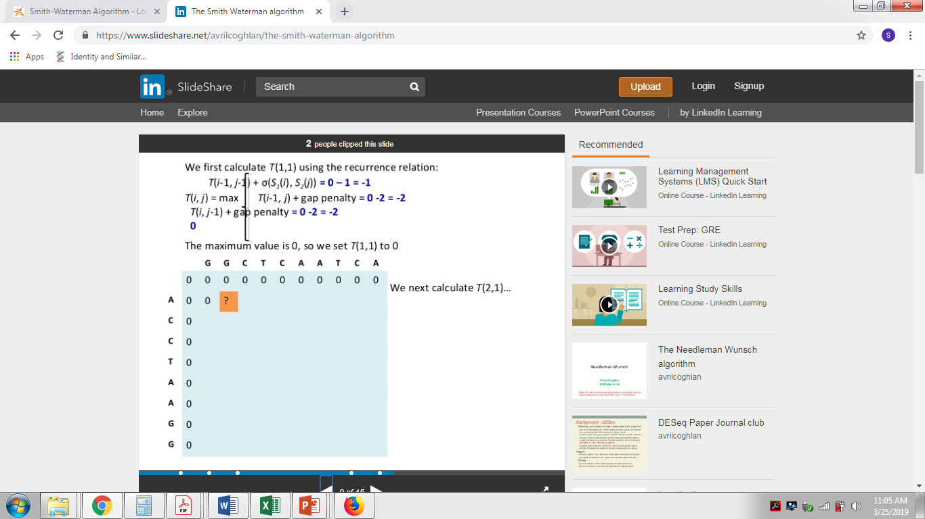
+2 FOR MATCH; -1 FOR MISMATCH; -2 FOR GAP

Slide 10
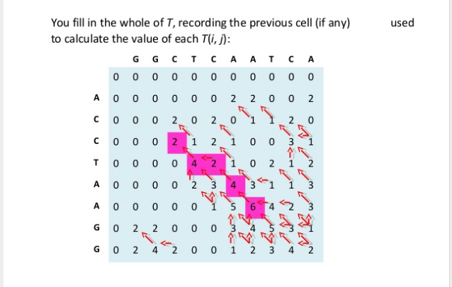

Slide 11
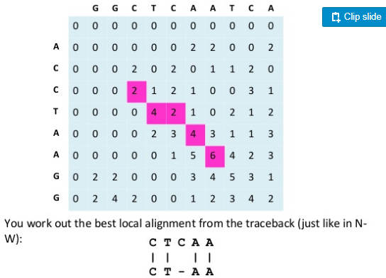

Slide 12
Phylogenetic tree analysis

Slide 13
Family tree- Phylogenetic tree
Phylogenetic trees illustrate the evolutionary relationships among groups of organisms, or among a family of related nucleic acid or protein sequences
How might have this family been derived during evolution?

Slide 14
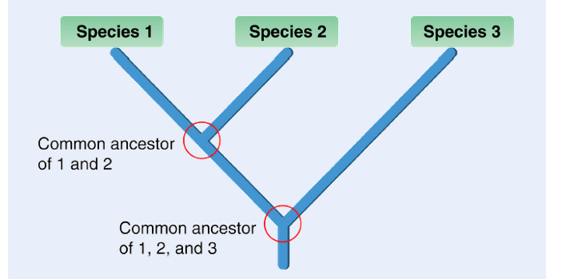
Hypothetical tree

Slide 15
Cladistics and other terms
The most common method of incorporating information into phylogenetic trees is called cladistics.
Cladistics depicts hypotheses about how organisms are related, based on traits of ancestor and descendent species. Cladistics was developed in the 1950s by a scientist named Willi Hennig. Over the next several decades, it became very popular, and is still widely used today.
The term cladistics comes from the word clade. A clade is a group of organisms that includes an ancestor species and all of its descendants. A diagram showing evolutionary relationships within one or more clades is called a cladogram. A clade is a relative concept. How you define a clade depends on which species you are interested in classifying. Small clades can includes as few as two species and their common ancestor. The larger clades can include many more species and their common ancestors.
https://opencurriculum.org/5365/phylogenetic-classification/

Slide 16
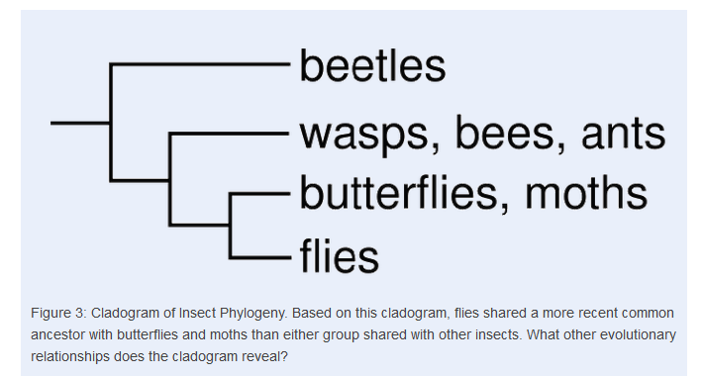

Slide 17
Generating Cladograms
Choose the traits- Physical or genetic
Which traits are inherited from which parents and group them?- Ancestral traits
Also identify which traits evolved only after branching from the parents.- Derived traits
Eg. A derived trait in birds is feathers. An ancestral trait will be presence of eyes
Note! A derived trait is not necessarily an entirely new trait. More often it is a modified form of an ancestral trait. For example, birds evolved feathers from the scales that were already present in their reptile ancestor. Similarly, mammals evolved fur from the scales of their reptile ancestor.

Slide 18
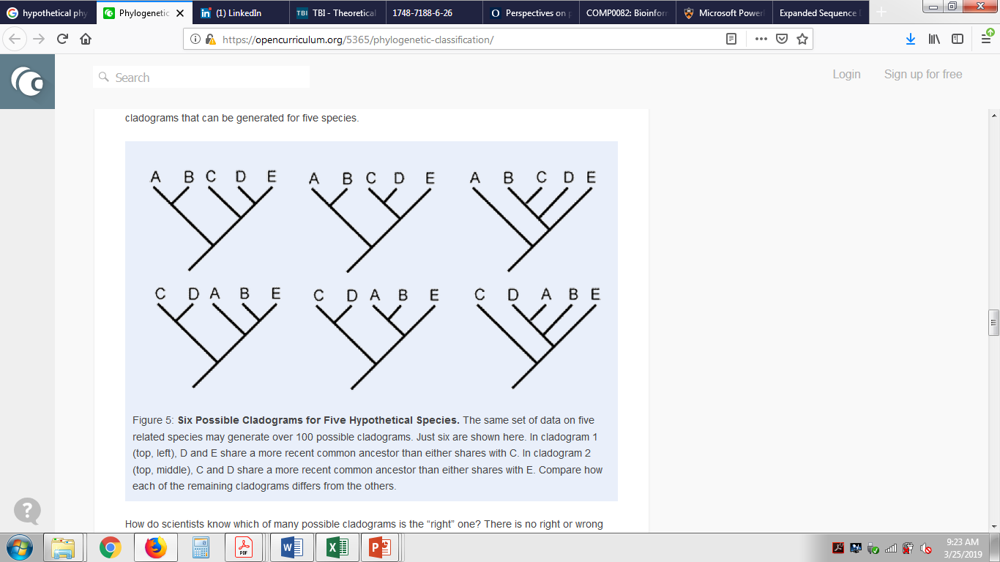
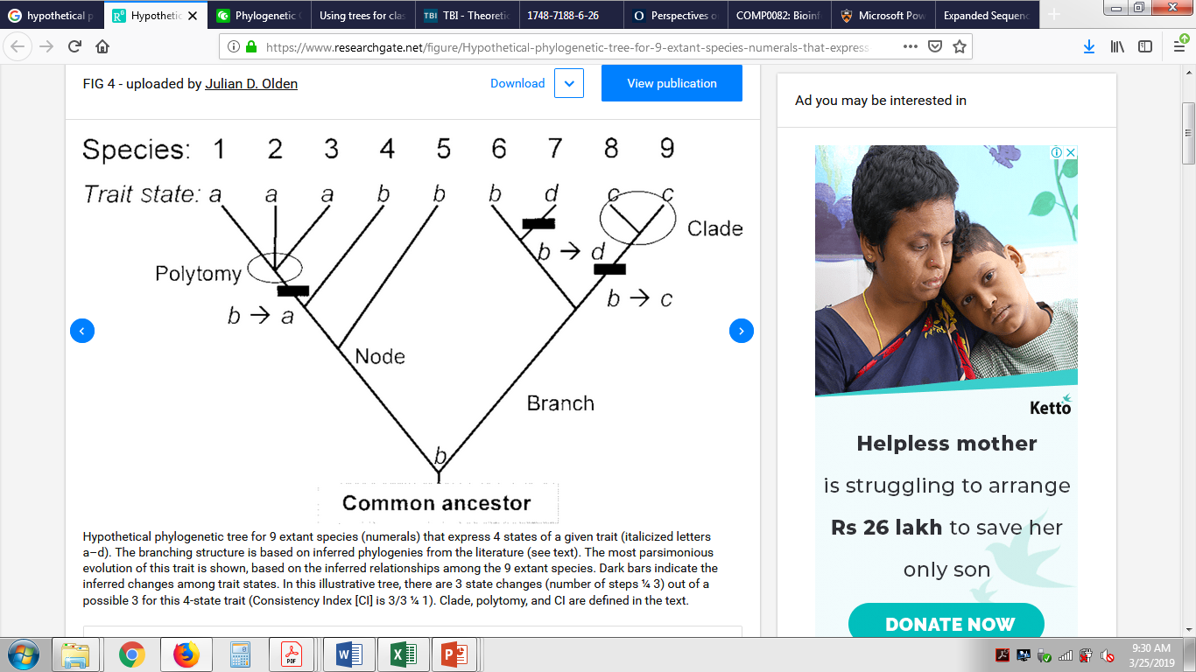
More cladograms are possible!
Hypothetically 6 out of more than 100 possible are represented below for a 5 member species

Slide 19
Lack of knowledge Usually, a polytomy means that we don't have enough data to figure out how those lineages are related. By not resolving that node, the scientists who produced the phylogeny are telling you not to draw any conclusions — and also to stay tuned: often gathering more data can resolve a polytomy.

Slide 20
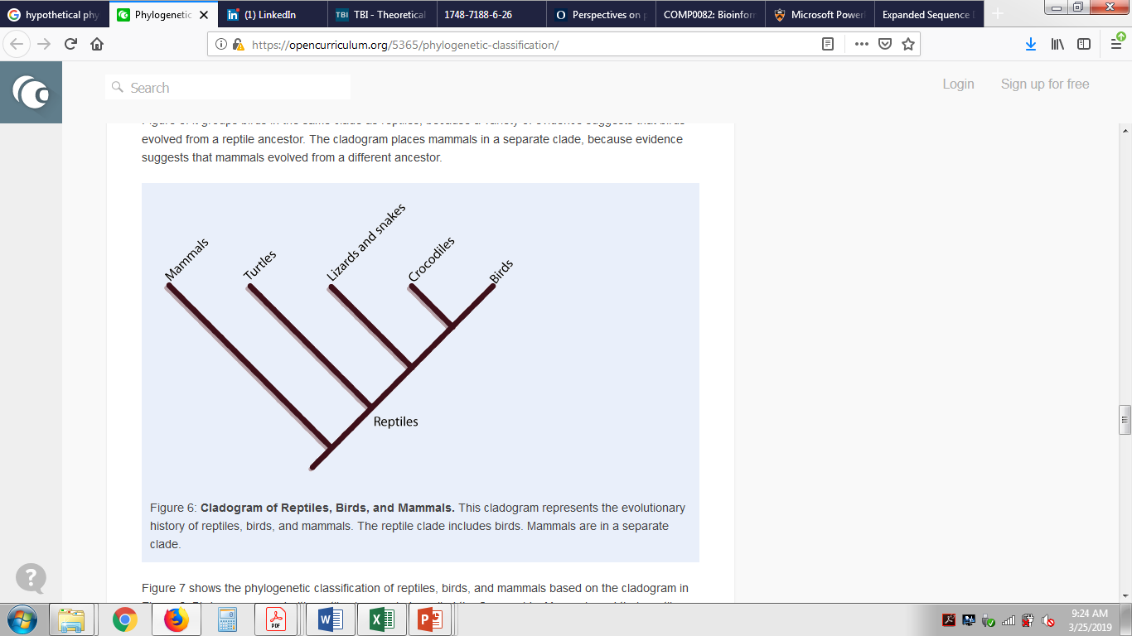
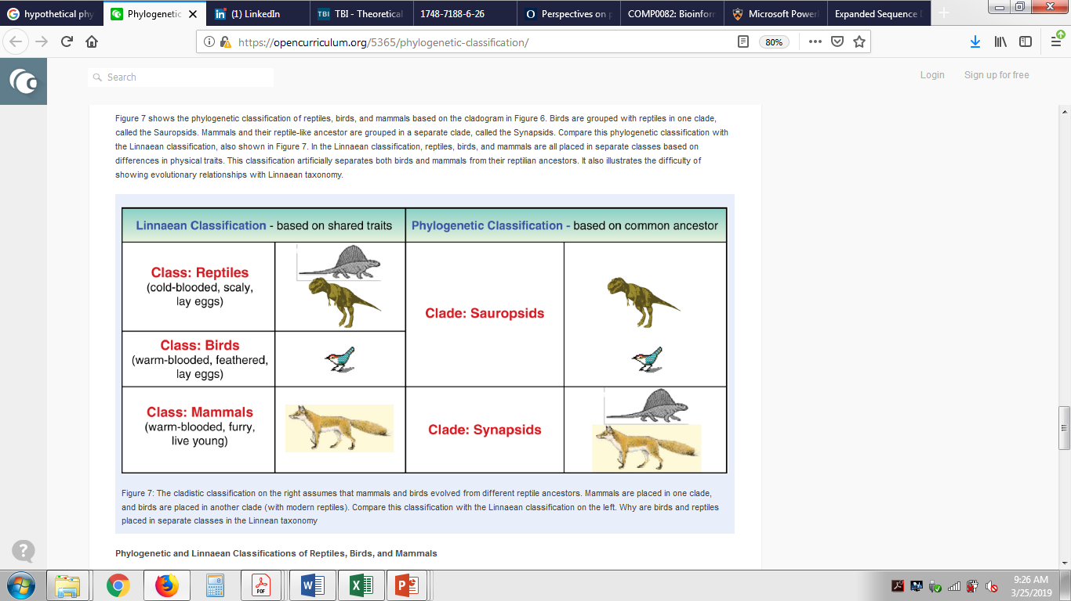
Linnaean[traditional] vs Phylogenetic classification

Slide 21
Reconstructing tress
Refer to this example on this website
https://evolution.berkeley.edu/evolibrary/article/0_0_0/phylogenetics_07

Slide 22
Phylogenetic Classification
Treats all levels of a cladogram as equivalent.
Places no limit on the number of levels in a ladogram.
Primary goal is to show the process of evolution.
It is limited to organisms that are related by ancestry.
Does not include a method for naming species.
Linnaean Classification
Treats each taxa uniquely and has a special name or each (e.g., genus, species).
Has fixed numbers and types of taxa.
Primary goal is to group species based on similarities in physical traits.
Can include any organisms without regard to ancestry.
Has a method for giving unique names to species.

Slide 23
Choosing the right traits
Traditionally, evidence for evolutionary relationships included similarities in physical traits of form or function. For example, in Linnaean taxonomy, homeothermy (warm-bloodedness) is one of the traits used to separate both birds and mammals from other animals
Convergent evolution. Using such traits misleading phylogenetic analysis
Similarities among nucleic acid base sequences provide some of the most direct evidence of evolutionary relationships.

Slide 24
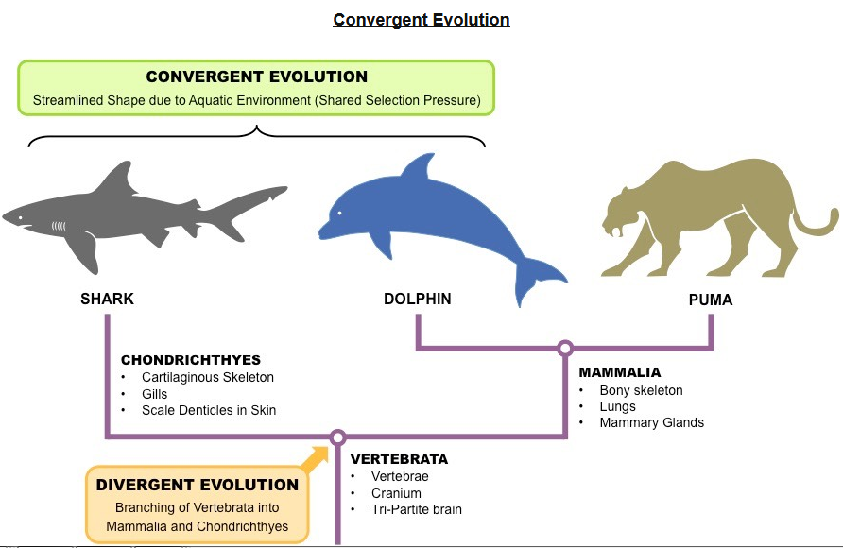

Slide 25
Differences Between Convergent and Divergent Evolution
Three main differences between convergent and divergent evolution are:
Convergent evolution shows how species have evolved separately but have similar (analogous) structures. Divergent evolution demonstrates how species can have common (homologous) anatomical structures which have evolved for different purposes.
Convergent evolution happens in organisms that are not closely related while divergent evolution is observed in organisms that are closely related.
The relationship between the analogous structures in different species that evolved through convergent evolution can be less distinct compared to the homologous structures seen in divergent evolution which have the same basic structural plan.
https://biologydictionary.net/difference-convergent-divergent-evolution/

Slide 26
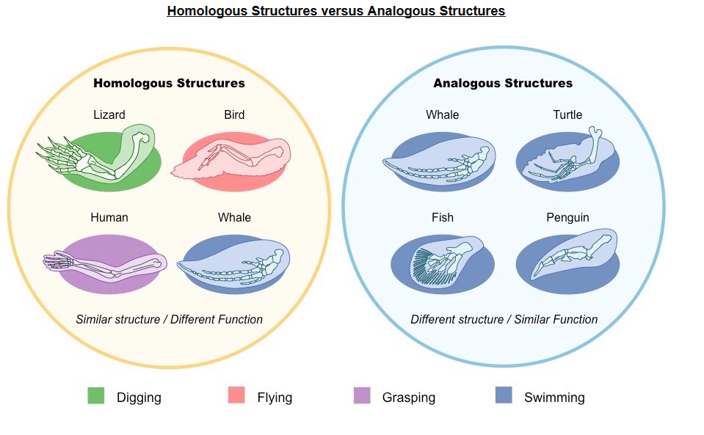
http://ib.bioninja.com.au/standard-level/topic-5-evolution-and-biodi/54-cladistics/structural-evidence.html

Slide 27
SWITCH TO THE PDF FILE for Lecture on methods

Slide 28
http://www.bioinf.uni-leipzig.de/~steigele/phylogeny.pdf
http://www.cs.tau.ac.il/~bchor/CG05/CG6-trees.pdf
https://www.cs.princeton.edu/~mona/Lecture/phylogeny-slides.pdf

